Slide 1
SMART CAMPUS
G.Sandeep

Slide 2
CONTENTS
Introduction
Components
Block Diagram
Modules
HCI
Roles and Responsibilities
Summary

Slide 3
INTRODUCTION
The aim of this project is to track and scan the BT/BLE tags, collect the information and store it on database. Access the database through application as per the requirement.

Slide 4
COMPONENTS
USB Dongle (CSR8510A10)
Mobiles (BT or BLE)
Beacons
Raspberry pi 3

Slide 5
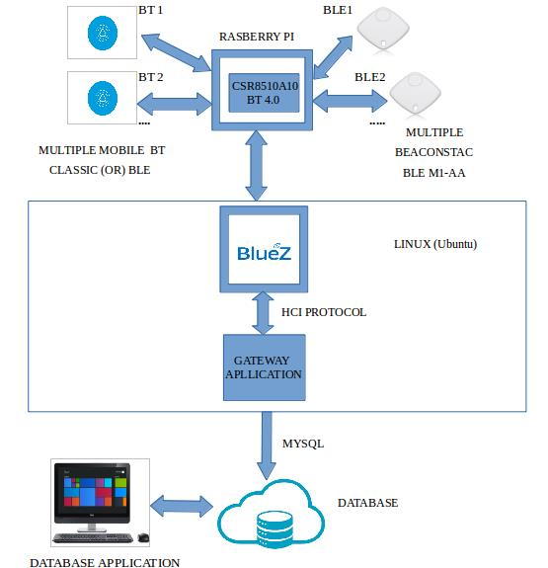
BLOCK DIAGRAM

Slide 6
MODULES
Gateway (DM)
Database (DB)
Application

Slide 7
HCI
Most Bluetooth systems consist of two layers:
The higher layers of the protocol stack (L2CAP, SDP, RFCOMM) are run on the host device’s processor.
The lower layers of the protocol stack (Baseband and radio) are run on specific Bluetooth hardware
HCI provides an interface between the higher and the lower layers of the protocol stack

Slide 8
ROLES AND RESPONSIBILITIES
I have involved in coding and database.
Code integration.

Slide 9
SUMMARY
Advantages of Bluetooth
Low power consumption
Low price on Bluetooth components
Non line-of-sight
Disadvantages of Bluetooth
Wireless LANs offer faster data rates and large communication ranges
Possibility of interference on 2.4GHz frequency band

Slide 10
Thank You

